Slide 1

Bonfire & Firework Safety :
Secondary School Level
#FireworkSafety
OFFICIAL
Notes:
Introduce yourself, where you work, what your role is and why you are there? ​
​
Learning Objectives​
How to act safely and sensibly around fireworks and bonfires​
How to become aware of the fire work code​
Understand why it is better to attend an organised local display if possible​

Slide 2
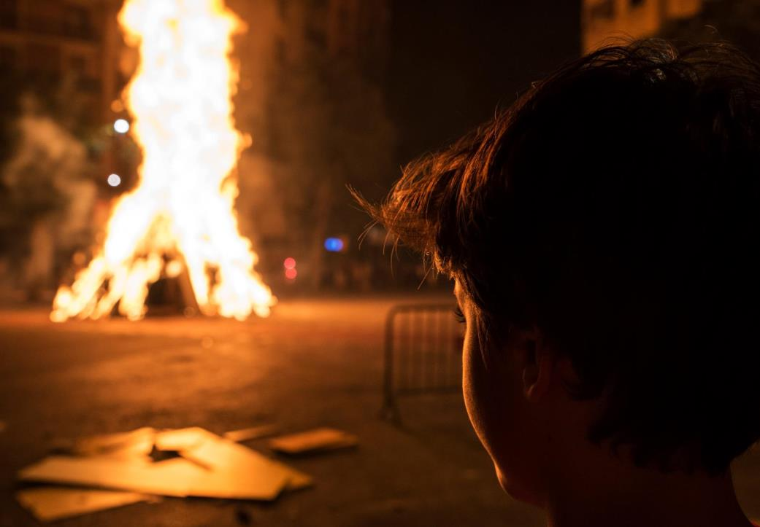
Bonfires
What to consider if you are going to have a bonfire
What is a safe Bonfire?
To reduce risks attend your local Bonfire Display. This year (2021) events may be limited or cancelled.
If you are having your own bonfire, remember to check for animals getting ready to hibernate
OFFICIAL
Notes:
Unsupervised bonfires put an additional strain on SFRS. 2020 – This year due to the current situation with Covid-19 events maybe limited or cancelled. It is therefore more important to make sure if you have to have a bonfire that you and those with you are safe.
ASK
If your parent/guardian is having a bonfire what should they consider?
ANSWER
One person should be responsible for the bonfire
Children should be supervised always
Keep a safe distance away from lit bonfires
Never throw fireworks or aerosols into bonfires
Keep a bucket of water handy in case of an accident
Avoid loose clothing and tie back long hair
At the end of the night, ensure that the fire is properly extinguished rather than leaving it to burn out.
ASK
What is a safe Bonfire?
ANSWER
The following criteria in considering if the bonfire is safe:
• It is positioned more than 18m from buildings
• It is less than 2.5 m in height
• It is positioned away from overhead cables
• There are no ‘secondary hazards’ within it (particularly gas cylinders/aerosols)
• The bonfire is being supervised by a responsible adult
If you are having your own bonfire remember to check for animals getting ready to hibernate.
Reinforce that SFRS recommend everyone to attend an organised event. You can find your nearest one on the SFRS website. In 2021 events may be limited or cancelled.

Slide 3

Always follow the Firework Code
FIREWORKS
Displays must finish before 11pm
2. Only buy fireworks with BS 7114 or CE mark
3. Follow the instructions on each firework
4. Light the firework at arm's length with a taper
5. Keep naked flames, including cigarettes, away from fireworks
6. Never return to a firework once it has been lit- even if it hasn't gone off it could still explode.
7. Don't put fireworks in pockets and never throw them
8. Direct any rocket fireworks well away from spectators
9. Never use paraffin or petrol on a bonfire
10. Make sure that the fire is out and surroundings are made safe before leaving.
OFFICIAL
Notes:
Discuss the firework code. Follow these simple guidelines to stay safe:
Only adults should deal with setting up firework displays, the lighting of fireworks and the safe disposal of fireworks once they have been used (and remember, alcohol and fireworks don't mix!). Children and young people should be supervised, and watch and enjoy fireworks at a safe distance.
1. Plan your firework display to make it safe and enjoyable, and ensure it finishes before 11pm (24:00 on 5th Nov, 01:00am for New years eve, Diwali, and Chinese New year)
2. Only buy fireworks with BS 7114 or CE mark, keep them in a closed metal box - take them out one at a time
3. Follow the instructions on each firework - read them in daylight or by torchlight, never by a naked flame.
4. Light the firework at arm's length with a taper and stand well back
5. Keep naked flames, including cigarettes, away from fireworks
6. Never return to a firework once it has been lit- even if it hasn't gone off it could still explode.
7. Don't put fireworks in pockets and never throw them
8. Direct any rocket fireworks well away from spectators
9. Never use paraffin or petrol on a bonfire
10. Make sure that the fire is out and surroundings are made safe before leaving.
ASK
Why do fireworks come in different shapes and sizes and are attractive to look at?
ANSWER:
This is a marketing technique as it makes them look exciting and fun. It is one of the ways that the firework manufacturers can sell these fireworks to the parents or guardians of the pupils and the public
ASK
Why should Fireworks not be kept in your pocket?
ANSWER
The friction could cause the firework to go off, causing serious injury and permanent damage.

Slide 4
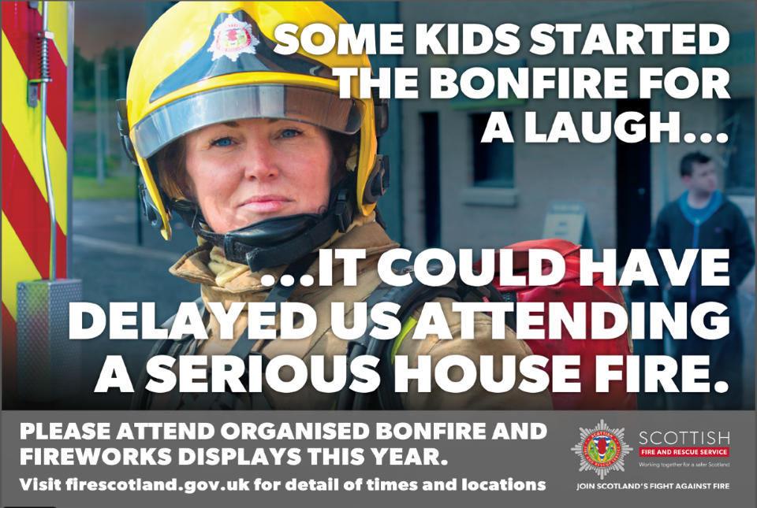
OFFICIAL
Notes:
Discuss how unofficial bonfires place a huge strain on fire and rescue resources and that they should help the fire service on bonfire night by attending an official display.

Slide 5
The Fireworks (Scotland) Miscellaneous Amendments Regulations 2021
New regulations came into place on the 30th June 2021
Changing the time fireworks can be sold; 7am-6pm
The quantity of fire works is now limited to 5kg
Changes to the time of day fireworks can be used between 6pm and 11pm
OFFICIAL
Notes:
Amending the times of day fireworks can be sold to the general public to during the daytime hours of 7am and 6pm, subject to the exceptions set out in the regulations and alongside existing requirements on retailers around sale and storage licenses.
The quantity of fireworks that can be supplied to the general public is restricted to 5kg at any one time, subject to exemptions set out in the regulations.
Changes the times of day fireworks can be used by the general public to between 6pm and 11pm, with the exception of 5 November (when they can be used from 6pm until midnight), New Year’s Eve, the night of Chinese New Year and the night of Diwali (when they can be used from 6pm until 1am).

Slide 6
The Unintended Outcomes
It is illegal for anyone under the age of 18 to purchase fireworks
You can incur a charge of £5000 if you're caught throwing a firework
Badly planned and positioned bonfires can lead to fire spread, such as positioning a bonfire close to trees, furniture and wheelie bins.
Hoax Calls
OFFICIAL
Notes:
Discuss that if SFRS are mobilised to bonfires that have spread, due to bad planning, or hoax calls, this puts a strain on resources that may be required elsewhere.
Highlight that it is not just hoax calls that put extra strain on SFRS but badly planned and positioned bonfires can lead to fire spread, which could have been avoided if precautions had been taken.
You may also want to discuss some of the topics below or ask the class if they are True/False
It is an offence:
To set off fireworks (by the general public) out-with the hours 6pm and 11pm (or after midnight on bonfire night, 1 am new years eve, Chinese new year, Diwali).
To modify, tamper with or misuse fireworks.
To throw or set off fireworks in any highway, street, thoroughfare or public place.
To sell fireworks to anyone under 18 and out-with the hours of 7am and 6pm
For anyone under 18 to possess fireworks in a public place.
For anyone other than a firework professional to possess display category fireworks.
To cause unnecessary suffering to any domestic or captive animals.
To buy more than 5kg of fireworks
Explain the following:
Hoax calls cost are approximately £2000 every time an appliance is mobilised whether this is to a real incident or a malicious one, it also reduces available resources from that area. Discuss the cost, not only in terms of monetary value but the potential cost in life due to resources being deployed maliciously when there could be an incident with a savable life.

Slide 7
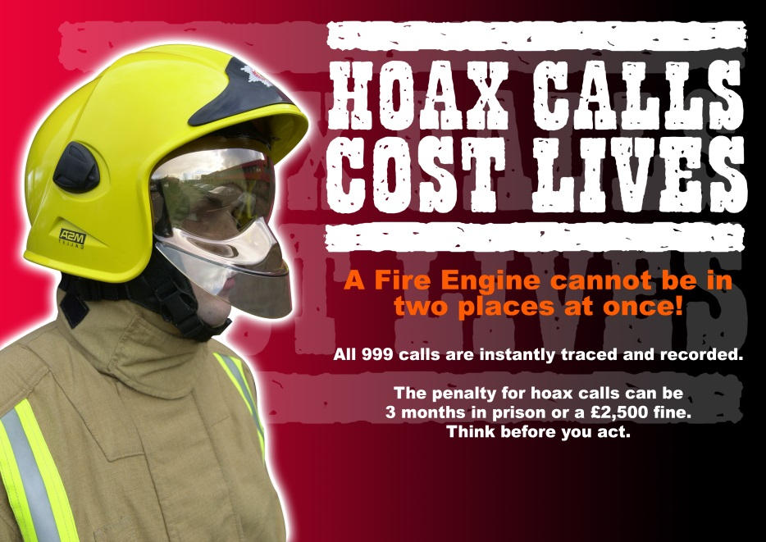
OFFICIAL
Notes:
Slide 7 Hoax Calls Cost Lives
Discuss the details on the slide.
Explain and Discuss
The SFRS could be delayed in attending a real emergency if they are called out to a false alarm. It could be someone you know who is in danger! This is extremely serious as they may not be able to attend fire calls such as:
House Fires
Road Traffic Collisions
Chemical Incidents
The outcome could end in serious injury or even death for the people or families involved
Explain that it is a serious offence to make a hoax call. It may lead to criminal proceedings being brought against any person charged with making a hoax call to the Emergency Services and they can be taken to court.
The penalties can be:
3 months imprisonment or
£2,500 fine
Or both
This is outlined in Section 85 False Alarms Fire (Scotland) Act 2005 above on slide 6.

Slide 8

OFFICIAL
Notes:
The video shows an example of what can happen if you throw aerosols into a bonfire.

Slide 9
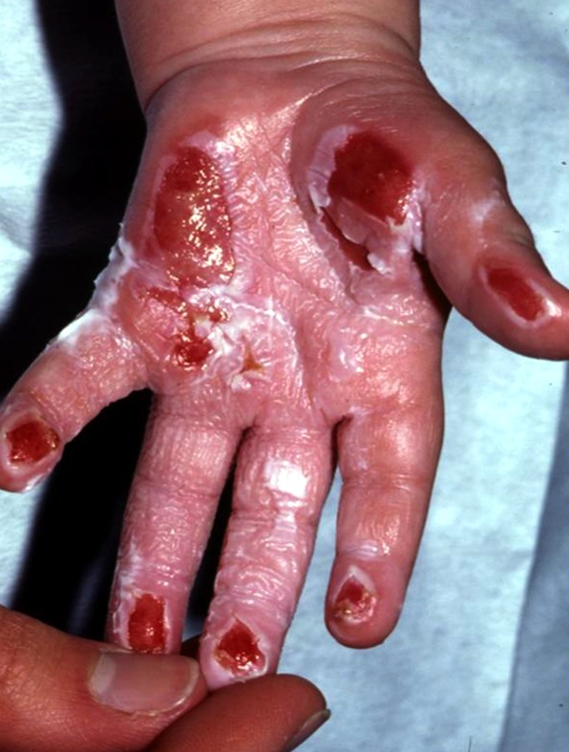
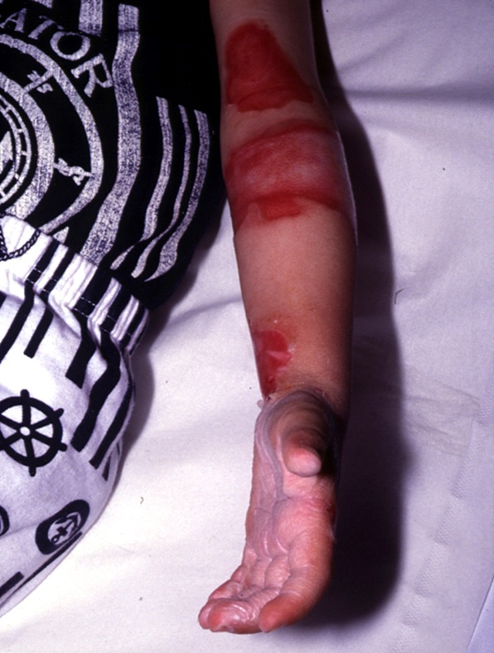
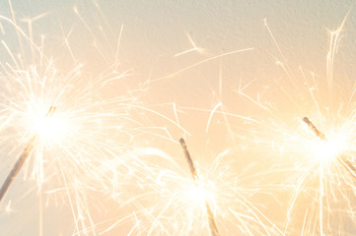
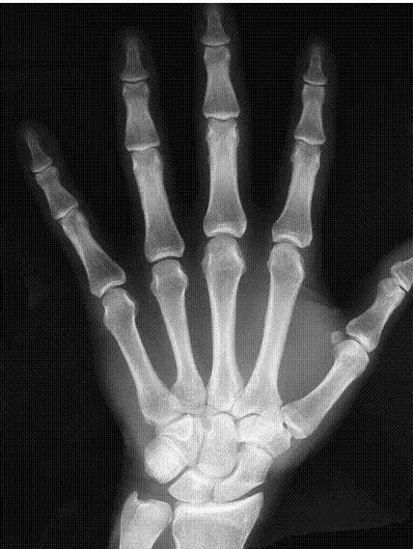
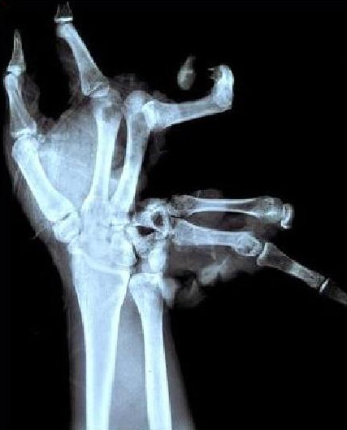
OFFICIAL
Notes:
Slide 6
Ask
How hot can sparklers get?
Answer
Sparklers can burn up to temperatures of 1500 degrees (5 times hotter than a BBQ) with fireworks reaching temperatures even hotter. These can cause a wide range of injuries including superficial and life altering injuries.
ASK
How old would you be before the burns go away?
Answer
It will never fully go away
ASK
What should you wear when you're holding a sparkler?
Answer
Gloves
The x-ray picture shows the damage that can be caused to a hand/fingers if a firework goes off in a persons hand.

Slide 10
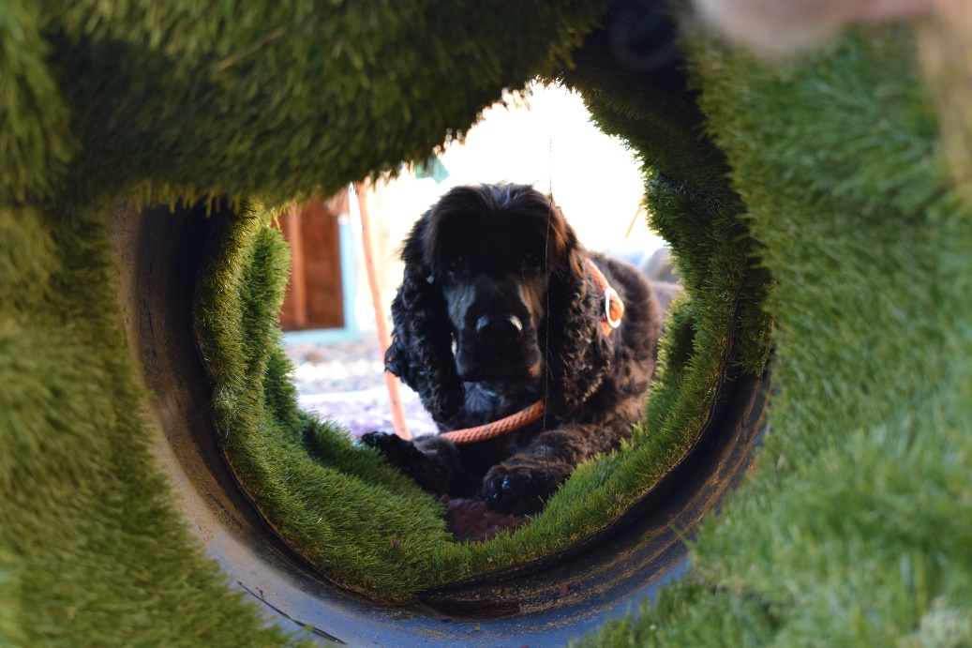
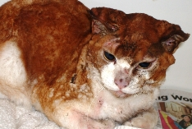
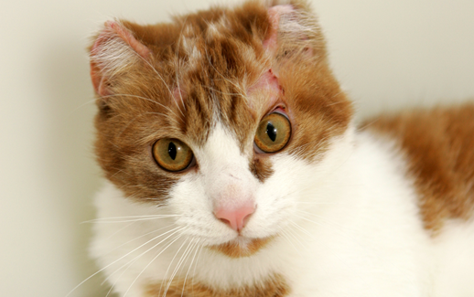
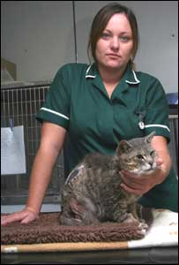
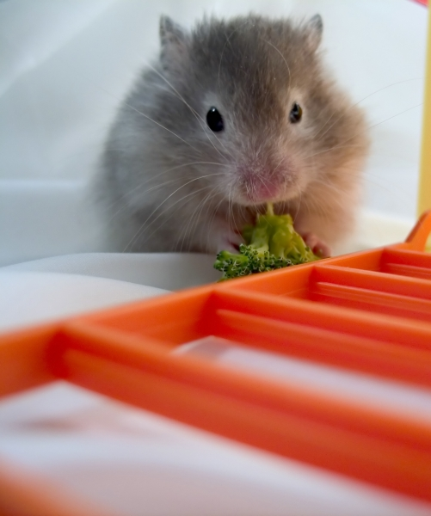

OFFICIAL
Notes:
Credit: Scottish SPCA re images
Bottom left (Cat)
A cat is recovering after an attack in which fireworks were taped to its side and set off.
The animal was found on Sunday morning suffering from substantial burns to its side and covered in masking tape.
The Scottish SPCA said the incident, in Drylaw, Edinburgh, had "shocked and horrified" animal welfare workers.
Police described the attack as a "horrific and deliberate act of cruelty" and appealed for witnesses to come forward.
The cat was found by a member of the public near Royston Mains Road.
The young, male cat was rushed to an emergency veterinary clinic for immediate medical treatment.
Christina Harkness, the vet who cared for the cat, said: "We are very pleased that he has survived this ordeal, as the attack could have quite easily killed him.
"I am disgusted that somebody tried to gain some pleasure from attacking a cat in this horrendous way.“
Spokeswoman for the Scottish SPCA, said attacks of this sort happen every year in the run up to bonfire night.
This attack was brutal and unprovoked," she said. "The people responsible for this despicable act need to be caught as they may be a danger to other animals, or even to other people."
The attack happened between 2100 BST on Saturday and 0830 GMT on Sunday morning.
A Lothian and Borders Police spokeswoman appealed for the cat's owner to come forward.
She said: "Fireworks in the wrong hands are dangerous, but in this case, could have been fatal for both the animal involved, and those who were abusing them."
This incident comes a year after a cat was attacked with fireworks and thrown onto a bonfire in Hamilton.
Top right and bottom right Cat called Fanta
We rescued Fanta when he was found burned and extremely frightened in Kirkcaldy.
The one year old ginger and white tom cat was discovered by a member of the public with severe burns to his face and body.
He received emergency veterinary care at our rehoming centre near Edinburgh, where we called him Fanta.
Chief Inspector John Chisholm said, "Fanta received severe burns to his ears and face and he was also badly singed over most of his coat.
"We believe he was scorched by a blast of searing heat, possibly from an ignited aerosol or something similar such as a firework.
"This was a horrendous thing to do to an animal. Unfortunately, we didn't receive the information we needed to identify the person responsible.
"Thankfully Fanta's injuries healed well in our care and he made a good recovery over time. The difference in him was amazing.
"After all of the trauma he went through, we were very happy when Fanta found a new home where he'll be loved and cared for the way he deserves."
Hamster:
An animal welfare charity has expressed disappointment after a man who taped a hamster to a firework was sentenced to 220 hours community service.
The Scottish SPCA said Steven Gordon, 20, from Glasgow, had subjected the animal to a terrible death.
Gordon was convicted of animal cruelty after trial at Glasgow Sheriff Court.
A Scottish SPCA spokeswoman said: "We were disappointed to hear that the sentence awarded in this case did not involve a custodial element."
Mobile phone footage showed the hamster being taped to a rocket which was then stuck in the ground and lit in Possilpark.
Sheriff Gillian Bryson sentenced Gordon to 220 hours community service.
The Scottish SPCA suggested the Scottish courts should follow the lead of some American states where psychiatric assessments are carried out anyone guilty of animal cruelty.
A spokeswoman added: "Significant research indicates that this level of violence to animals can often progress as teenagers get older.“
Impact on dogs (Top right)
Behaviours such as avoidance (eg. hiding away, not eating and agitation) and overt behaviours (eg. barking,
spinning, tail-chewing) that occur as dogs try to cope with the perceived threat.
Dogs exhibiting a strong ‘flight response’, - may injure themselves or others.
Damage to furnishings and carpets as dogs may try to chew or dig their way out of rooms when shut in to get
away from the noise.
These behaviours can be extremely challenging for owners to address because fireworks remain out of their
control and therefore they are unable to remove the triggers for their dog’s fearful behaviour.
Impact on other animals – please refer to Scottish SPCA / BVA Handout

Slide 11
Attacks on Crews
Firefighters are here to keep everyone safe especially on Bonfire Night.
If a firefighter or a fire engine is attacked they cannot help someone who needs them.
What would happen if someone you loved needed our help because they were in a house fire or a road traffic incident.
Notes:
"Emergency services act"
Use of vehicle dash cams
Its not only physical attacks but includes verbal abuse.
Some areas will have to wait for police escorts prior to entering.
Paraphrasing ACO Lewis Ramsay –
“Firefighters are here to protect you and to make sure you have a safe Bonfire Night. They are someone’s Father, Brother, Mother, Sister- they are a part of your community. Do not Abuse or attack our crews during this Bonfire period”

Slide 12


Reporting
Fearless.org is urging young people across Scotland to be fearless in speaking up about fireworks misuse and deliberate fire raising 100% anonymously through the online form
Notes:
Discuss Why would reporting something you know, help the fire service?
If you know or suspect anything about fires that have been started deliberately in your area or who is responsible for fireworks misuse, you can be fearless in speaking up 100% anonymously at fearless.org
They can’t track your IP address or any contact details. Simply tell them what you know NOT who you are.
www.fearless.org

Slide 13

Any Questions?
OFFICIAL
Notes:
Any Questions about bonfires or fireworks?

