Slide 1


Slide 2

Firework and Bonfire Safety Presentation
Primary Level
Firework &
Bonfire Safety Input:
Primary School
#FireworkSafety
Notes:
Slide 2.
Introduce yourself, where you work, your role and why you are there.
Today we are going to talk about
How to act safely around fireworks and bonfires
How to be aware of the fire work code
Why it is better to attend an organised local fireworks display and bonfire (explain that this year (2021) there may not be any local organised events due to restrictions. Highlight that if parents or family friends are hosting a garden event they must follow the fireworks code).

Slide 3
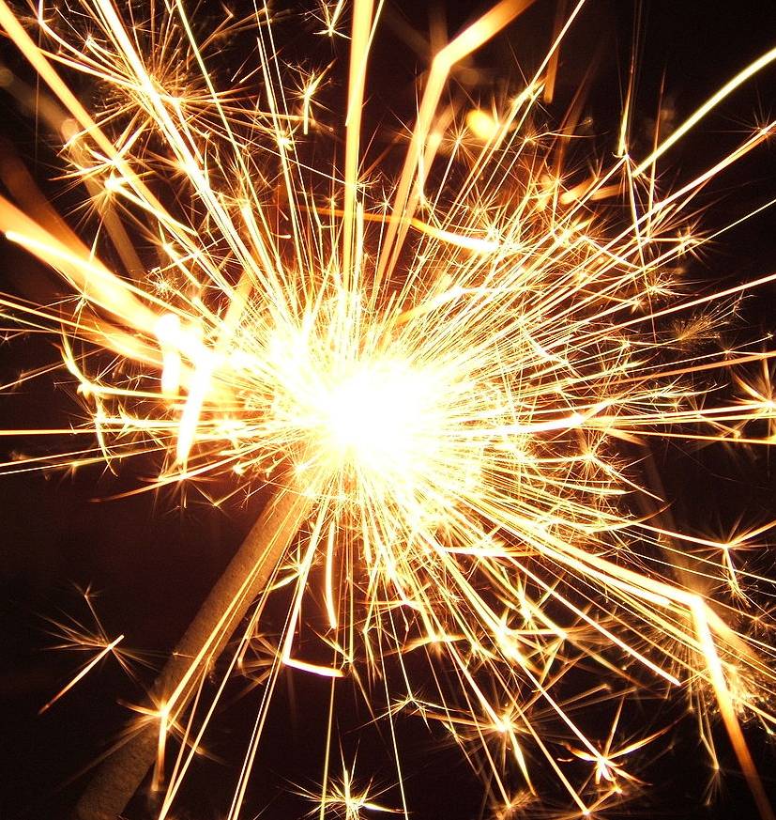
SPARKLERS
What age should you be before you can hold or use a sparkler?
What should you wear when holding a sparkler ?
How many sparklers should you use at one time?
Where should you put a sparkler once it’s finished?
This Photo by Unknown Author is licensed under CC BY-SA
Notes:
Slide 3
Talk through the slide and if appropriate go through what the learners should do in an emergency.
Answer 1 – Under 5’s should not be given sparklers and only use sparklers under the supervision of an adult
Answer 2 – Always wear Gloves.
Answer 3 – One. There are more injuries caused by Sparklers each year than any other Firework
Answer 4 - Put it in a bucket of water, hot end down.
In an emergency where someone has been burned
Cool the burn or scald with cold water for at least 10 minutes
Cut around material sticking to the skin - don't pull it of
Don't touch the burn or burst any blisters
If clothing catches fire - Stop, Drop to the floor and Roll them in heavy material like a curtain
Get advice from your doctor or accident and emergency department at your local hospital
Highlight that some people think that some fireworks are safe especially sparklers.
Point out to the class that Sparklers can burn at temperatures up to 1500°C.
ASK if they can guess how many times higher than the following is a sparkler:
boiling water = 15 times
boiling oil = 8 times
barbecue = 5 times

Slide 4
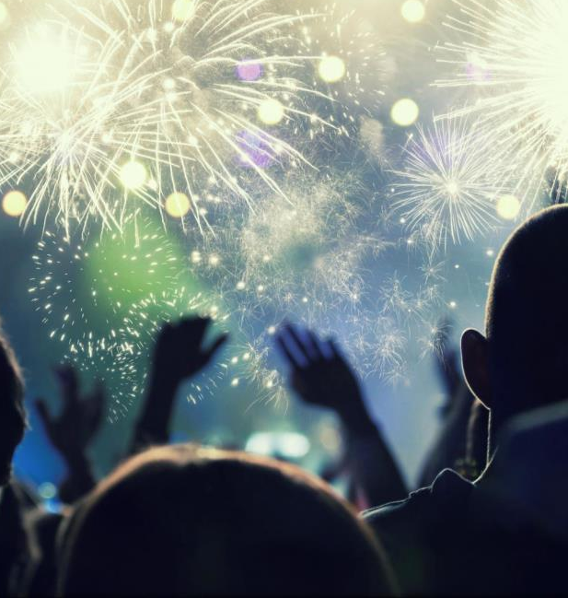
Follow the Firework Code
Only adults should touch fireworks
Always stand back from Fireworks and Bonfires
When holding sparklers, always wear gloves
Notes:
Slide 4
Discuss the firework code.
Only adults should deal with setting up firework displays, the lighting of fireworks and the safe disposal of fireworks once they have been used (and remember, alcohol and fireworks don't mix!). Children and young people should be supervised, and watch and enjoy fireworks at a safe distance. Follow these top 10 tips for a safer fireworks party:
Plan your firework display to make it safe and enjoyable, and ensure it doesn't start before 6pm finishes before 11pm (midnight on 5th Nov, 1am for the new year, Chinese new year and Diwali)
Only buy fireworks which carry the CE mark, keep them in a closed box and use them one at a time
Read and follow the instructions on each firework using a torch if necessary
Light the firework at arm's length with a taper and stand well back
Keep naked flames, including cigarettes, away from fireworks
Never return to a firework once it has been lit
Don't put fireworks in pockets and never throw them
Direct any rocket fireworks well away from spectators
Never use paraffin or petrol on a bonfire
Make sure that the fire is out and surroundings are made safe before leaving.
Own notes
ASK
Why do fireworks come in different shapes and sizes and are attractive to look at?
ANSWER:
This is (a marketing technique) a way the people who sell fireworks make them look exciting and fun. It is one of the ways that the firework manufacturers are able to sell these fireworks to the parents or guardians of the pupils and the public
ASK
Why should Fireworks not be kept in your pocket?
ANSWER
The friction could cause the firework to go off, causing serious injury and permanent damage.

Slide 5
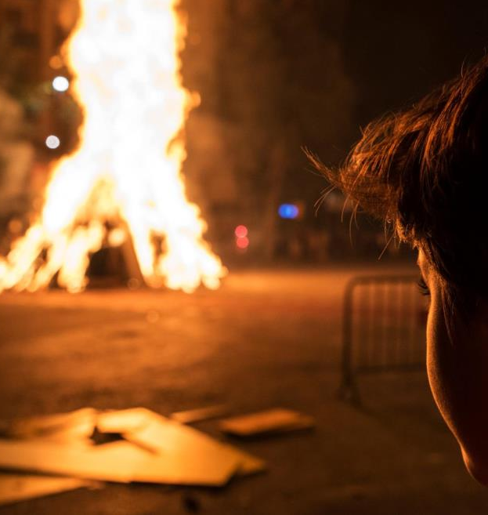
Bonfires
To reduce risks attend your local Bonfire Display. This year (2021) events may be limited or cancelled.
If you are having your own bonfire remember to check for animals getting ready to hibernate
Never throw anything onto a Bonfire
An adult should always be present if there is a Bonfire
Stand far back away from the Bonfire
Notes:
Slide 5
Unsupervised bonfires put an additional strain on SFRS. 2021 – This year due to the current situation with Covid-19 events maybe limited or cancelled. It is therefore more important to make sure if you have to have a bonfire that you and those with you are safe.
ASK
If your parent/guardian is having a bonfire what should they consider?
ANSWER
One person should be responsible for the bonfire
Children should be supervised always
Keep a safe distance away from lit bonfires
Never throw fireworks or aerosols into bonfires
Keep a bucket of water handy in case of an accident
Avoid loose clothing and tie back long hair
At the end of the night, ensure that the fire is properly extinguished rather than leaving it to burn out.
ASK
What is a safe Bonfire?
ANSWER
The following criteria in considering if the bonfire is safe:
• It is positioned more than 18m from buildings
• It is less than 2.5 m in height
• It is positioned away from overhead cables
• There are no ‘secondary hazards’ within it (particularly gas cylinders/aerosols)
• The bonfire is being supervised by a responsible adult
If you are having your own bonfire remember to check for animals getting ready to hibernate.
Reinforce that SFRS recommend everyone to attend an organised event. You can find your nearest one on the SFRS website. In 2021 events may be limited or cancelled.

Slide 6

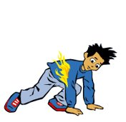
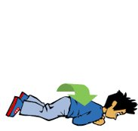
Stop Drop and Roll
Notes:
Slide 6
Prior to the lesson discuss with the class teacher if demonstrating the Stop Drop and Roll safety message is appropriate.
Reinforce the message to the class to stay away from fire.
ASK
If your clothes DID catch on fire what must you do?
ANSWER
Stop where you are.
Drop to the ground and cover your eyes and mouth with your hands. Roll over and over and back and forth until the flames are out.
Get help from a grown-up who will cool the burn and get medical help.
Additional notes for consideration
Children often get confused about when to stop, drop, and roll. Stress the importance of knowing when to do this behaviour. Only do it when clothing catches fire. Children who do not have a good understanding of stop, drop, and roll will sometimes do this if they burn a finger or need to get outside if the smoke alarm sounds. Using stop, drop, and roll under the wrong circumstances could be very dangerous.

Slide 7
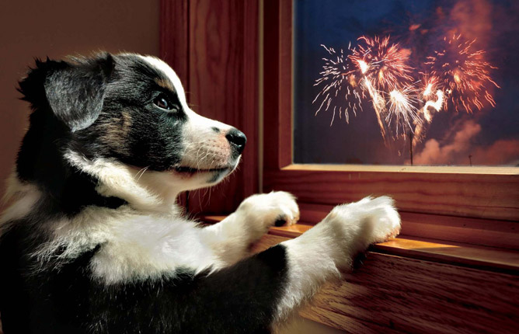
Animals
Notes:
Slide 7
Animals don’t understand why we have Bonfire Night or fireworks. They can get scared and upset very easily because of the loud noises, bright lights and smoke.
Ensure all animals are in a safe place.
Bring outdoor pets indoors where possible or put their cage in a garage or shed.
Exercise pets during daylight hours.
Have background noise e.g. radio or the T.V.
Shut curtains & give your pet access to a safe place to hide.
Check bonfires before lighting them for animals that maybe trying to hibernate, for example hedgehogs.

Slide 8

Notes:
Slide 8
Listen to Ben’s story.

Slide 9
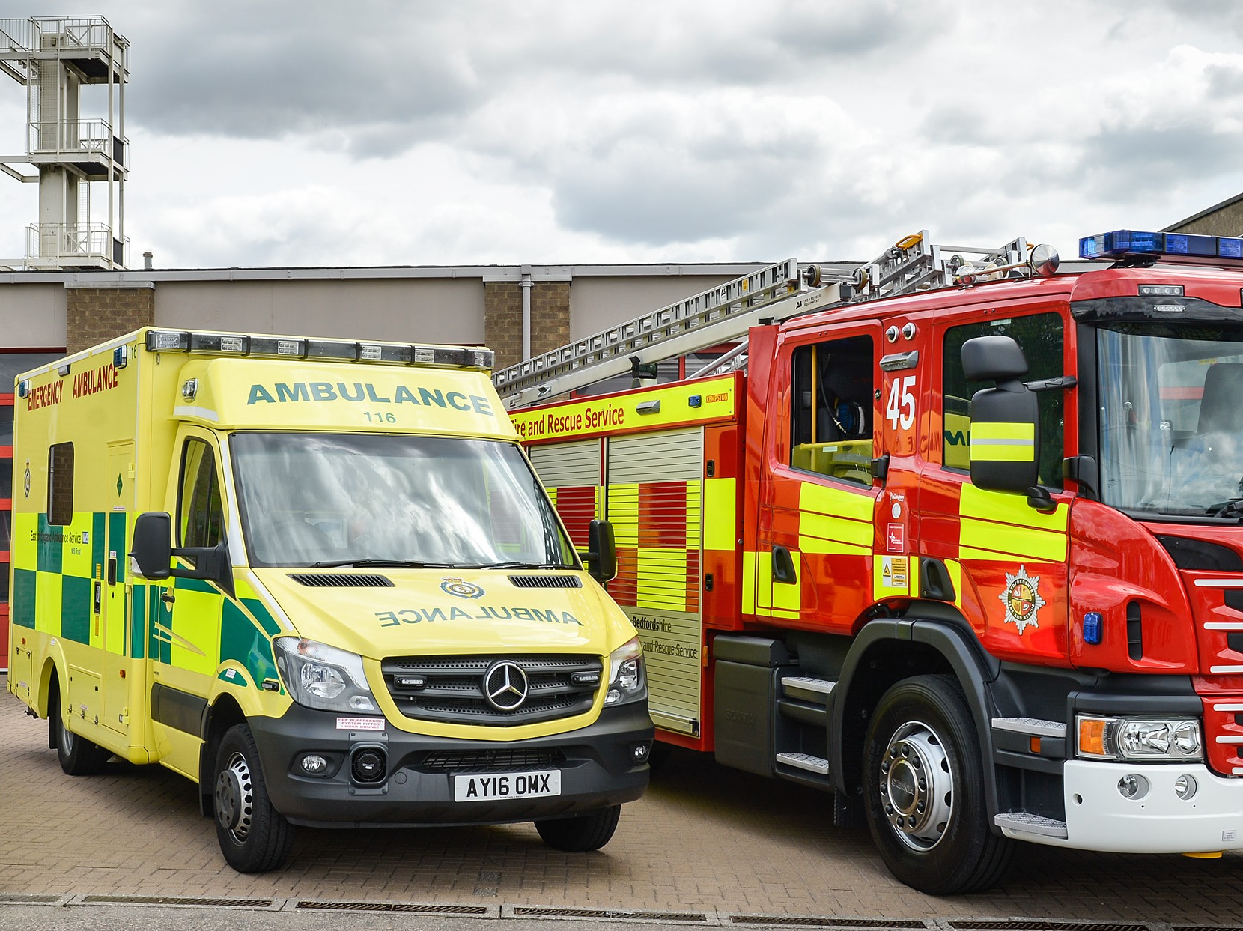
Calling the Emergency Services
Notes:
SLIDE 9 Discuss the procedure for calling the emergency services to report an emergency.
ASK
Who are the emergency services? And what is the number to call?
Information they will need to know if making a call
Which emergency service is required
Address of the incident, including postcode
Detail about the emergency – who, what, where?
ASK
Does everyone know their own address?

Slide 10
Quiz
1.When is Bonfire Night?
5th November
2.What age do you have to be to buy fireworks?
18 years or older
3.What age should you be before you can hold a sparkler?
5 years
4.What do you do once a sparkler is finished?
Put it into a bucket of water, hot end down
5.Who should light a firework?
A responsible adult
6.What should you do if your clothes catch fire?
Stop, Drop and Roll
7.How much does it cost to call for Emergency service?
Nothing, calling 999 is free but should only be called in an emergency
Notes:
Slide 10
Left click once for the answer.
End the power point by going over the key safety messages and answering any questions the class may have.

Slide 11
Notes:
Slide 11
Any Questions about bonfires or fireworks?

